Slide 1
CHAPTER 4 Evaluating a Company’s Resources, Capabilities, and Competitiveness

Slide 2
LEARNING OBJECTIVES
THIS CHAPTER WILL HELP YOU UNDERSTAND:
How to take stock of how well a company’s strategy is working
Why a company’s resources and capabilities are centrally important in giving the company a competitive edge over rivals
How to assess the company’s strengths and weaknesses in light of market opportunities and external threats
How a company’s value chain activities can affect the company’s cost structure and customer value proposition
How a comprehensive evaluation of a company’s competitive situation can assist managers in making critical decisions about their next strategic moves

Slide 3
EVALUATING A FIRM’S INTERNAL SITUATION
How well is the firm’s present strategy working?
What are the firm’s competitively important resources and capabilities?
Is the firm able to take advantage of market opportunities and overcome external threats to its well-being?
Are the firm’s prices and costs competitive with those of key rivals, and does it have an appealing customer value proposition?
Is the firm competitively stronger or weaker than key rivals?
What strategic issues and problems merit front-burner managerial attention?

Slide 4
QUESTION 1: HOW WELL IS THE FIRM’S PRESENT STRATEGY WORKING?
The three best indicators of how well a company’s strategy is working are:
Whether the company is achieving its stated financial and strategic objectives
Whether its financial performance is above the industry average
Whether it is gaining customers and increasing its market share

Slide 5
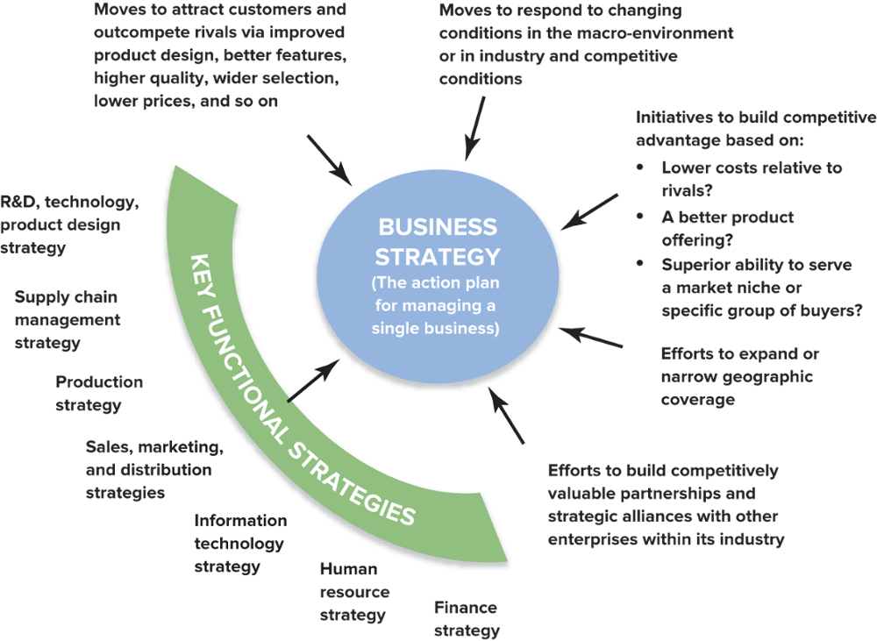
FIGURE 4.1 Identifying the Components of a Single-Business Company’s Strategy
Jump to Appendix 1 long image description

Slide 6
SPECIFIC INDICATORS OF STRATEGIC SUCCESS
Trends in the firm’s sales and earnings growth
Trends in the firm’s stock price
The firm’s overall financial strength
The firm’s customer retention rate
The rate at which new customers are acquired
Evidence of improvement in internal processes such as defect rate, order fulfillment, delivery times, days of inventory, and employee productivity

Slide 7
STRATEGIC MANAGEMENT PRINCIPLE (1 of 14)
Sluggish financial performance and second-rate market accomplishments almost always signal weak strategy, weak execution, or both.

Slide 8
TABLE 4.1 Key Financial Ratios: How to Calculate Them and What They Mean (1 of 8)
Profitability Ratios | How Calculated | What It Shows
Gross profit margin | Sales revenues − Cost of goods sold Sales revenues | Shows the percentage of revenues available to cover operating expenses and yield a profit.
Operating profit margin (or return on sales) | Sales revenues − Operating expenses Sales revenues or Operating income Sales revenues | Shows the profitability of current operations without regard to interest charges and income taxes. Earnings before interest and taxes is known as EBIT in financial and business accounting.
Net profit margin (or net return on sales) | Profits after taxes Sales revenues | Shows after-tax profits per dollar of sales.
Total return on assets | Profits after taxes + Interest Total assets | A measure of the return on total investment in the enterprise. Interest is added to after-tax profits to form the numerator, since total assets are financed by creditors as well as by stockholders.
Jump to Appendix 2 long image description

Slide 9
TABLE 4.1 Key Financial Ratios: How to Calculate Them and What They Mean (2 of 8)
Profitability Ratios | How Calculated | What It Shows
Net return on total assets (ROA) | Profits after taxes Total assets | A measure of the return earned by stockholders on the firm’s total assets.
Return on stockholders’ equity (ROE) | Profits after taxes Total stockholders’ equity | The return stockholders are earning on their capital investment in the enterprise. A return in the 12%–15% range is average.
Return on invested capital (ROIC)—sometimes referred to as return on capital employed (ROCE)​ | Profits after taxes Long-term debt + Total stockholders’ equity | A measure of the return that shareholders are earning on the monetary capital invested in the enterprise. A higher return reflects greater bottom-line effectiveness in the use of long-term capital.
Jump to Appendix 2 long image description

Slide 10
TABLE 4.1 Key Financial Ratios: How to Calculate Them and What They Mean (3 of 8)
Liquidity Ratios | How Calculated | What It Shows
Current ratio | Current assets Current liabilities | Shows a firm’s ability to pay current liabilities using assets that can be converted to cash in the near term. Ratio should be higher than 1.0.
Working capital | Current assets − Current liabilities | The cash available for a firm’s day-to-day operations. Larger amounts mean the company has more internal funds to (1) pay its current liabilities on a timely basis and (2) finance inventory expansion, additional accounts receivable, and a larger base of operations without resorting to borrowing or raising more equity capital.
Jump to Appendix 3 long image description

Slide 11
TABLE 4.1 Key Financial Ratios: How to Calculate Them and What They Mean (4 of 8)
Leverage Ratios | How Calculated | What It Shows
Total debt-to-assets ratio | Total debt Total assets | Measures the extent to which borrowed funds (both short-term loans and long-term debt) have been used to finance the firm’s operations. A low ratio is better—a high fraction indicates overuse of debt and greater risk of bankruptcy.
Long-term debt-to-capital ratio | Long-term debt Long-term debt + Total stockholders’ equity | A measure of creditworthiness and balance-sheet strength. It indicates the percentage of capital investment that has been financed by both long-term lenders and stockholders. A ratio below 0.25 is preferable since the lower the ratio, the greater the capacity to borrow additional funds. Debt-to-capital ratios above 0.50 indicate an excessive reliance on long-term borrowing, lower creditworthiness, and weak balance- sheet strength.
Jump to Appendix 4 long image description

Slide 12
TABLE 4.1 Key Financial Ratios: How to Calculate Them and What They Mean (5 of 8)
Leverage Ratios | How Calculated | What It Shows
Debt-to-equity ratio | Total debt Total stockholders’ equity | Shows the balance between debt (funds borrowed, both short term and long term) and the amount that stockholders have invested in the enterprise. The further the ratio is below 1.0, the greater the firm’s ability to borrow additional funds. Ratios above 1.0 put creditors at greater risk, signal weaker balance sheet strength, and often result in lower credit ratings.
Long-term debt-to-equity ratio | Long-term debt Total stockholders’ equity | Shows the balance between long-term debt and stockholders’ equity in the firm’s long-term capital structure. Low ratios indicate a greater capacity to borrow additional funds if needed.
Times-interest-earned (or coverage) ratio | Operating income Interest expenses | Measures the ability to pay annual interest charges. Lenders usually insist on a minimum ratio of 2.0, but ratios above 3.0 signal progressively better creditworthiness.
Jump to Appendix 4 long image description

Slide 13
TABLE 4.1 Key Financial Ratios: How to Calculate Them and What They Mean (6 of 8)
Activity Ratios | How Calculated | What It Shows
Days of inventory | Inventory Cost of goods sold ÷ 365 | Measures inventory management efficiency. Fewer days of inventory are better.
Inventory turnover | Cost of goods sold Inventory | Measures the number of inventory turns per year. Higher is better.
Average collection period | Accounts receivable Total sales ÷ 365 or Accounts receivable Average daily sales | Indicates the average length of time the firm must wait after making a sale to receive cash payment. A shorter collection time is better.
Jump to Appendix 4 long image description

Slide 14
TABLE 4.1 Key Financial Ratios: How to Calculate Them and What They Mean (7 of 8)
Other Ratios | How Calculated | What It Shows
Dividend yield on common stock | Annual dividends per share Current market price per share | A measure of the return that shareholders receive in the form of dividends. A “typical” dividend yield is 2%–3%. The dividend yield for fast-growth companies is often below 1%; the dividend yield for slow-growth companies can run 4%–5%.
Price-to-earnings (P/E) ratio | Current market price per share Earnings per share | P/E ratios above 20 indicate strong investor confidence in a firm’s outlook and earnings growth; firms whose future earnings are at risk or likely to grow slowly typically have ratios below 12.
Dividend payout ratio | Annual dividends per share Earnings per share | Indicates the percentage of after-tax profits paid out as dividends.
Jump to Appendix 5 long image description

Slide 15
TABLE 4.1 Key Financial Ratios: How to Calculate Them and What They Mean (8 of 8)
Other Ratios | How Calculated | What It Shows
Internal cash flow | After-tax profits + Depreciation | A rough estimate of the cash a company’s business is generating after payment of operating expenses, interest, and taxes. Such amounts can be used for dividend payments or funding capital expenditures.
Free cash flow | After-tax profits + Depreciation – Capital expenditures – Dividends | A rough estimate of the cash a company’s business is generating after payment of operating expenses, interest, taxes, dividends, and desirable reinvestments in the business. The larger a company’s free cash flow, the greater its ability to internally fund new strategic initiatives, repay debt, make new acquisitions, repurchase shares of stock, or increase dividend payments.
Jump to Appendix 5 long image description

Slide 16
QUESTION 2: WHAT ARE THE FIRM’S MOST IMPORTANT RESOURCES AND CAPABILITIES, AND WILL THEY GIVE THE FIRM A LASTING COMPETITIVE ADVANTAGE OVER RIVAL COMPANIES?
Competitive assets
Are the firm’s resources and capabilities
Are the determinants of its competitiveness and ability to succeed in the marketplace
Are what a firm’s strategy depends on to develop sustainable competitive advantage over its rivals

Slide 17
CORE CONCEPTS (1 of 9)
A resource is a competitive asset that is owned or controlled by a firm.
A capability or competence is the capacity of a firm to perform an internal activity competently through deployment of a firm’s resources.
A firm’s resources and capabilities represent its competitive assets and are determinants of its competitiveness and ability to succeed in the marketplace.

Slide 18
IDENTIFYING THE FIRM'S RESOURCES AND CAPABILITIES
A resource:
A productive input or competitive asset that is owned or controlled by a firm (e.g., a fleet of oil tankers)
A capability:
The capacity of a firm to perform some activity proficiently (e.g., superior skills in marketing)

Slide 19
STRATEGIC MANAGEMENT PRINCIPLE (2 of 14)
Resource and capability analysis is a powerful tool for sizing up a firm’s competitive assets and determining if they can support a sustainable competitive advantage over market rivals.

Slide 20
TABLE 4.2 Types of Company Resources (1 of 2)
Tangible resources
Physical resources: land and real estate; manufacturing plants, equipment, or distribution facilities; the locations of stores, plants, or distribution centers, including the overall pattern of their physical locations; ownership of or access rights to natural resources (such as mineral deposits)
Financial resources: cash and cash equivalents; marketable securities; other financial assets such as a company’s credit rating and borrowing capacity
Technological assets: patents, copyrights, production technology, innovation technologies, technological processes
Organizational resources: IT and communication systems (satellites, servers, workstations, etc.); other planning, coordination, and control systems; the company’s organizational design and reporting structure
Jump to Appendix 6 long image description

Slide 21
TABLE 4.2 Types of Resources (2 of 2)
Intangible resources
Human assets and intellectual capital: the education, experience, knowledge, and talent of the workforce, cumulative learning, and tacit knowledge of employees; collective learning embedded in the organization, the intellectual capital and know-how of specialized teams and work groups; the knowledge of key personnel concerning important business functions; managerial talent and leadership skill; the creativity and innovativeness of certain personnel
Brands, company image, and reputational assets: brand names, trademarks, product or company image, buyer loyalty and goodwill; company reputation for quality, service, and reliability; reputation with suppliers and partners for fair dealing
Relationships: alliances, joint ventures, or partnerships that provide access to technologies, specialized know-how, or geographic markets; networks of dealers or distributors; the trust established with various partners
Company culture and incentive system: the norms of behavior, business principles, and ingrained beliefs within the company; the attachment of personnel to the company’s ideals; the compensation system and the motivation level of company personnel
Jump to Appendix 6 long image description

Slide 22
IDENTIFYING CAPABILITIES
An organizational capability
Is the intangible but observable capacity of a firm to perform a critical activity proficiently using a related combination (cross-functional bundle) of its resources
Is knowledge-based, residing in people and in a firm’s intellectual capital or in its organizational processes and systems, emboding tacit knowledge

Slide 23
CORE CONCEPTS (2 of 9)
A resource bundle is a linked and closely integrated set of competitive assets centered around one or more cross-functional capabilities.
The VRIN Test for sustainable competitive advantage asks if a resource is Valuable, Rare, Inimitable, and Non-substitutable.

Slide 24
VRIN TESTING: RESOURCES AND CAPABILITIES
Identifying the firm’s resources and capabilities by testing the competitive power of its resources and capabilities:
Is the resource (or capability) competitively valuable?
Is the resource rare—is it something rivals lack?
Is the resource hard to copy (inimitable)?
Is the resource invulnerable to the threat of substitution of different types of resources and capabilities (non-substitutable)?

Slide 25
VRIN: FOUR TESTS OF A RESOURCE’S COMPETITIVE POWER
Support for competitive advantage?
Support for sustained competitive advantage?
Resource
Valuable
Inimitable
Rare
Nonsubstitutable
Jump to Appendix 7 long image description

Slide 26
CORE CONCEPTS (3 of 9)
Social complexity (company culture, interpersonal relationships among managers or R&D teams, trust-based relations with customers or suppliers) and causal ambiguity are two factors that inhibit the ability of rivals to imitate a firm’s most valuable resources and capabilities.
Causal ambiguity makes it very hard to figure out how a complex resource contributes to competitive advantage and therefore exactly what to imitate.

Slide 27
STRATEGIC MANAGEMENT PRINCIPLE (3 of 14)
A firm requires a dynamically evolving portfolio of resources and capabilities to sustain its competitiveness and help drive improvements in its performance.

Slide 28
CORE CONCEPT (4 of 9)
A dynamic capability is the ongoing capacity of a firm to modify its existing resources and capabilities or create new ones by:
Improving existing resources and capabilities incrementally
Adding new resources and capabilities to the firm’s competitive asset portfolio

Slide 29
MANAGING RESOURCES AND CAPABILITIES DYNAMICALLY
Threats to resources and capabilities
Rivals providing better substitutes over time
Capabilities decaying from benign neglect
Disruptive competitive environment change
Manage capabilities dynamically by:
Attending to the ongoing modification of existing competitive assets
Taking advantage of any opportunities to develop totally new kinds of capabilities

Slide 30
QUESTION 3: WHAT ARE THE FIRM’S STRENGTHS AND WEAKNESSES IN RELATION TO MARKET OPPORTUNITIES AND EXTERNAL THREATS?
SWOT Analysis
Is a powerful tool for sizing up a firm’s:
Internal strengths (the basis for strategy)
Internal weaknesses (deficient capabilities)
Market opportunities (strategic objectives)
External threats (strategic defenses)

Slide 31
CORE CONCEPT (5 of 9)
SWOT analysis is a simple but powerful tool for sizing up a company’s strengths and weaknesses, its market opportunities, and the external threats to its future well-being.

Slide 32
STRATEGIC MANAGEMENT PRINCIPLE (4 of 14)
Basing a company’s strategy on its most competitively valuable strengths gives the company its best chance for market success.

Slide 33
IDENTIFYING A COMPANY’S INTERNAL STRENGTHS
A competence:
Is an activity that a firm has learned to perform with proficiency—a true capability
A core competence:
Is a proficiently performed internal activity that is central to a firm’s strategy and competitiveness
A distinctive competence:
Is a competitively valuable activity that a firm performs better than its rivals

Slide 34
Core Concepts (6 of 9)
A competence is an activity that a firm has learned to perform with proficiency—a capability, in other words.
A core competence is an activity that a firm performs proficiently and that is also central to its strategy and competitive success.
A distinctive competence is a competitively important activity that a firm performs better than its rivals—it thus represents a competitively superior internal strength.

Slide 35
IDENTIFYING A FIRM’S WEAKNESSES AND COMPETITIVE DEFICIENCIES
A weakness (competitive deficiency):
Is something a firm lacks or does poorly (in comparison to others) or a condition that puts it at a competitive disadvantage in the marketplace
Types of weaknesses
Inferior skills, expertise, or intellectual capital
Deficiencies in physical, organizational, or intangible assets
Missing or competitively inferior capabilities in key areas

Slide 36
Core CONCEPTS (7 of 9)
A firm’s strengths represent its competitive assets.
A firm’s weaknesses are shortcomings that constitute competitive liabilities.

Slide 37
IDENTIFYING A COMPANY’S MARKET OPPORTUNITIES
Characteristics of market opportunities
An absolute “must pursue” market:
Represents much potential but is hidden in “fog of the future”
A marginally interesting market:
Presents high risk and questionable profit potential
An unsuitable or mismatched market:
Is best avoided as the firm’s strengths are not matched to market factors

Slide 38
STRATEGIC MANAGEMENT PRINCIPLE (5 of 14)
A company is well advised to pass on a particular market opportunity unless it has or can acquire the competencies needed to capture it.

Slide 39
IDENTIFYING THREATS TO A FIRM’S FUTURE PROFITABILITY
Types of threats:
Normal course-of-business threats
Sudden-death (survival) threats
Considering threats
Identify the threats to the firm’s future prospects
Evaluate what strategic actions can be taken to neutralize or lessen their impact

Slide 40
TABLE 4.3 What to Look for in Identifying a Company’s Strengths, Weaknesses, Opportunities, and Threats (1 of 4)
Potential Strengths and Competitive Assets | Potential Weaknesses and Competitive Deficiencies
Competencies that are well matched to industry key success factors | No clear strategic vision
Ample financial resources to grow the business | No well-developed or proven core competencies
Strong brand-name image or company reputation | No distinctive competencies or competitively superior resources
Economies of scale or learning- and experience-curve advantages over rivals | Lack of attention to customer needs
Other cost advantages over rivals | A product or service with features and attributes that are inferior to those of rivals
Attractive customer base | Weak balance sheet, few financial resources to grow the firm, too much debt
Proprietary technology, superior technological skills, important patents | Higher overall unit costs relative to those of key competitors

Slide 41
TABLE 4.3 What to Look for in Identifying a Company’s Strengths, Weaknesses, Opportunities, and Threats (2 of 4)
Potential Strengths and Competitive Assets (continued) | Potential Weaknesses and Competitive Deficiencies (continued)
Strong bargaining power over suppliers or buyers | Too narrow a product line relative to rivals
Resources and capabilities that are valuable and rare | Weak brand image or reputation
Resources and capabilities that are hard to copy and for which there are no good substitutes | Weaker dealer network than key rivals or lack of adequate distribution capability
Superior product quality | Lack of management depth
Wide geographic coverage or strong global distribution capability | A plague of internal operating problems or obsolete facilities
Alliances or joint ventures that provide access to valuable technology competencies, or attractive geographic markets | Too much underutilized plant capacity
 | Resources that are readily copied or for which there are good substitutes

Slide 42
TABLE 4.3 What to Look for in Identifying a Company’s Strengths, Weaknesses, Opportunities, and Threats (3 of 4)
Potential Market Opportunities | Potential External Threats to a Company’s Future Profitability
Meeting sharply rising buy demand for the industry’s product | Increasing intensity of competition among industry rivals—may squeeze profit margins
Serving additional customer groups or market segments | Slowdowns in market growth
Expanding into new geographic markets | Likely entry of potent new competitions
Expanding the company’s product line to meet a broader range of customer needs | Growing bargaining power of customers or suppliers
Utilizing existing company skills or technological know-how to enter new product lines or new businesses | A shift in buyer needs and tastes away from the industry’s product
 | Adverse demographic changes that threaten to curtail demand for the industry’s product

Slide 43
TABLE 4.3 What to Look for in Identifying a Company’s Strengths, Weaknesses, Opportunities, and Threats (4 of 4)
Potential Market Opportunities (continued) | Potential External Threats to a Company’s Future Profitability (continued)
Taking advantage of failing trade barriers in attractive foreign markets | Adverse economic conditions that threaten critical suppliers or distributors
Acquiring rival firms or companies with attractive technological expertise or capabilities | Changes in technology—particularly disruptive technology that can undermine the company’s distinctive competencies
Taking advantage of emerging technological developments to innovate Entering into alliances or joint ventures to expand the firm’s market coverage or boost its competitive capability | Restrictive foreign trade policies Costly new regulatory requirements Tight credit conditions Rising prices on energy or other key inputs

Slide 44
Strategic Management Principle (6 of 14)
Simply making lists of a company’s strengths, weaknesses, opportunities, and threats is not enough.
The payoff from SWOT analysis comes from the conclusions about a company’s situation and the implications for strategy improvement that flow from the four lists.

Slide 45
WHAT DO SWOT LISTINGS REVEAL?
SWOT analysis involves:
Drawing conclusions from the SWOT listings about the firm’s overall situation
Translating these conclusions into strategic actions by the firm that:
Match its strategy to its internal strengths and to market opportunities
Correct important weaknesses and defend it against external threats

Slide 46
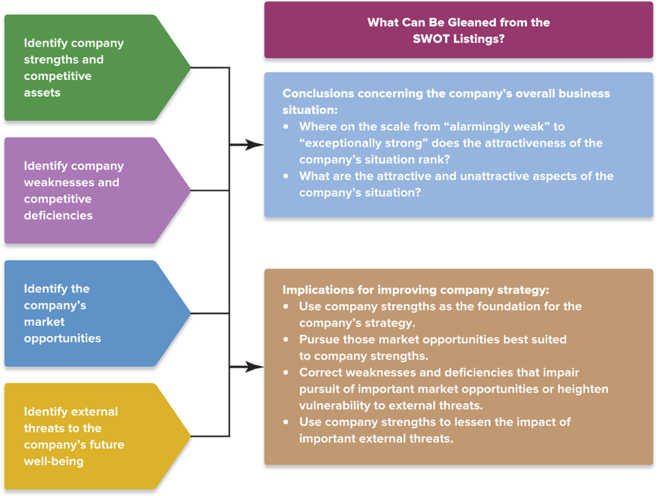
FIGURE 4.2 The Steps Involved in SWOT Analysis: Identify the Four Components of SWOT, Draw Conclusions, Translate Implications into Strategic Actions
Jump to Appendix 8 long image description

Slide 47
USING SWOT ANALYSIS
What are the attractive aspects of the firm’s situation?
What aspects are of the most concern?
Are the firm’s internal strengths and competitive assets sufficiently strong to enable it to compete successfully?
Are the firm’s weaknesses and competitive deficiencies correctable, or could they be fatal if not remedied soon?
Do the firm’s strengths outweigh its weaknesses by an attractive margin?
Does the firm have attractive market opportunities that are well suited to its internal strengths?
Does the firm lack the competitive assets (internal strengths) to pursue the most attractive opportunities?
Where on a scale of 1 to 10 (1 = weak and 10 = strong) do the firm’s overall situation and future prospects rank?

Slide 48
QUESTION 4: HOW DO A FIRM’S VALUE CHAIN ACTIVITIES IMPACT ITS COST STRUCTURE AND CUSTOMER VALUE PROPOSITION?
Signs of a firm’s competitive strength:
Its prices and costs are in line with rivals
Its customer-value proposition is competitive and cost effective
Its bundled capabilities are yielding a sustainable competitive advantage

Slide 49
Strategic Management Principle (7 of 14)
The higher a firm’s costs are above those of close rivals, the more competitively vulnerable it becomes.
Conversely, the greater the amount of customer value that a firm can offer profitably relative to close rivals, the less competitively vulnerable the firm becomes.

Slide 50
THE CONCEPT OF A COMPANY VALUE CHAIN
The value chain:
Identifies the inner workings of the firm's customer value proposition and business model
Permits a deep look at the firm’s cost structure and its ability to profitably offer low prices
Reveals the emphasis that a firm places on activities that enhance differentiation and support higher prices

Slide 51
Core Concept (8 of 9)
A company’s value chain identifies the primary activities and related support activities that create customer value.

Slide 52
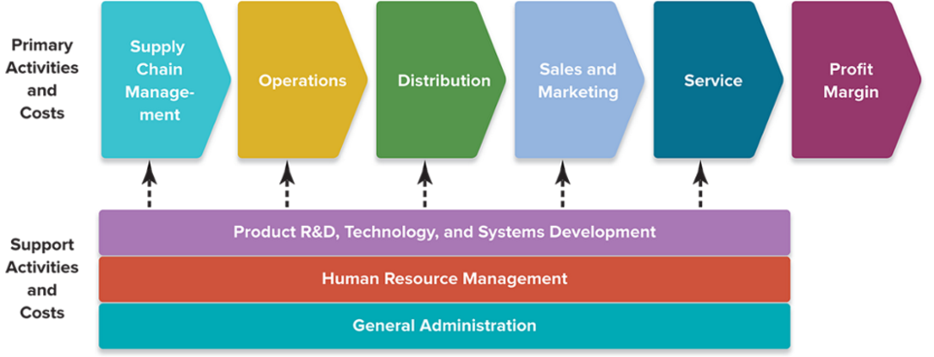
FIGURE 4.3 A Representative Company Value Chain
Jump to Appendix 9 long image description

Slide 53
COMPARING THE VALUE CHAINS OF RIVAL FIRMS
Value chain analysis
Facilitates a comparison, activity-by-activity, of how effectively and efficiently a firm delivers value to its customers, relative to its competitors
The value chain analysis process:
Segregates the firm’s operations into different types of primary and secondary activities to identify the major components of its internal cost structure
Uses activity-based costing to evaluate the activities
Does the same for significant competitors

Slide 54
VALUE CHAIN SYSTEM FOR AN ENTIRE INDUSTRY
Industry value chain
The firm’s internal value chain
The value chains of industry suppliers
The value chains of channel intermediaries
Effects of the industry value chain
Costs and margins of suppliers and channel partners can affect prices to end consumers
Activities of channel partners can affect industry sales volumes and customer satisfaction

Slide 55
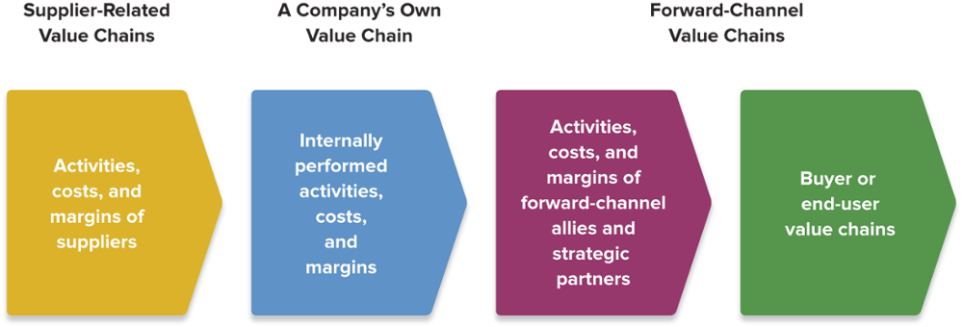
FIGURE 4.4 A Representative Value Chain System
Jump to Appendix 10 long image description

Slide 56
Illustration Capsule 4.1 The Value Chain for Boll & Branch
A king-size set of sheets from Boll & Branch is made from 6 meters of fabric, requiring 11 kilograms of raw cotton.
Raw Cotton | $ 28.16
Spinning/Weaving/Dyeing | 12.00
Cutting/Sewing/Finishing | 9.50
Material Transportation | 3.00
Factory Fee | 15.80
Cost of Goods |  | $68.46
Inspection Fees | 5.48
Ocean Freight/Insurance | 4.55
Import Duties | 8.22
Warehouse/Packing | 8.50
Packaging | 15.15
Customer Shipping | 14.00
Promotions/Donations | 30.00
Total Cost |  | $154.38
Boll & Brand Markup | About 60%
Boll & Brand Retail Price |  | $250.00
Gross Margin |  | $ 95.62
Jump to Appendix 11 long image description

Slide 57
The Value Chain for Boll & Branch
Which activities in the value chain are primary activities? Which are secondary activities?
Which activities are linked to the value chain for the entire industry?
Where in the industry activity chain could Boll & Branch possibly reduce cost(s) without reducing its competitive strength?

Slide 58
Strategic Management Principle (8 of 14)
A firm’s cost competitiveness depends not only on the costs of internally performed activities (its own value chain) but also on costs in the value chains of its suppliers and distribution channel allies.

Slide 59
Core Concept (9 of 9)
Benchmarking is a potent tool for improving a company’s own internal activities that is based on learning how other companies perform them and borrowing their “best practices.”

Slide 60
USING BENCHMARKING TO ASSESS A FIRM’S VALUE CHAIN ACTIVITIES
Benchmarking:
Involves improving a firm’s internal activities based on learning from other firms’ “best practices”
Assesses whether the cost competitiveness and effectiveness of a firm’s value chain activities are in line with its competitors’ activities
Sources of benchmarking information
Reports, trade groups, analysts, and customers
Visits to benchmark companies
Data from consulting firms

Slide 61
Strategic Management Principle (9 of 14 )
Benchmarking the costs of a firm's activities against those of rivals provides hard evidence of whether the firm is cost-competitive.

Slide 62
DELIVERED-COST BENCHMARKING IN THE CEMENT INDUSTRY
Which of the five benchmarked manufacturing and logistics costs are likely to be most affected by fluctuating market conditions?
Why is the collection of competitive intelligence to accurately benchmark delivered costs of such importance in the cement industry?
How could key data about competitors published by the PCA create an temptation for unethical price fixing, market or customer allocation schemes, dealing arrangements, bid rigging, or bribery in the industry?

Slide 63
STRATEGIC OPTIONS FOR REMEDYING A COST OR VALUE DISADVANTAGE
Areas in the total value chain system for a firm to look for ways to improve its efficiency and effectiveness:
The firm’s own internal activity segments
The suppliers’ part of the value chain system
The forward channel portion of the value chain system

Slide 64
IMPROVING INTERNALLY PERFORMED VALUE CHAIN ACTIVITIES
Implement best practices throughout the firm, particularly for high-cost activities.
Eliminate cost-producing activities altogether by redesigning products and revamping the internal value chain.
Relocate high-cost activities to areas where they can be performed more cheaply.
Outsource activities that can be performed by vendors or contractors more cheaply than if done in-house.
Invest in productivity-enhancing, cost-saving technological improvements.
Find ways to detour around activities or items where costs are high.
Redesign products or components to facilitate speedier and more economical manufacture or assembly.

Slide 65
IMPROVING THE EFFECTIVENESS OF THE CUSTOMER VALUE PROPOSITION AND ENHANCING DIFFERENTIATION
Implement best practices for quality of high-value activities.
Adopt best practices and technologies that spur innovation, improve design, and enhance creativity.
Implement the best practices in providing customer service.
Reallocate resources to activities having the most impact on value for the customer and their most important purchase criteria.
For intermediate buyers, gain an understanding of how the activities the firm performs impact the buyer’s value chain.
Adopt best practices for marketing, brand management, and enhancing customer perceptions.

Slide 66
IMPROVING SUPPLIER-RELATED VALUE CHAIN ACTIVITIES
Pressure suppliers for lower prices.
Switch to lower-priced substitute inputs.
Collaborate closely with suppliers to identify mutual cost-saving opportunities.
Work with suppliers to enhance the firm’s differentiation.
Select and retain suppliers who meet higher-quality standards.
Coordinate with suppliers to enhance design or other features desired by customers.
Provide incentives to suppliers to meet higher-quality standards, and assist suppliers in their efforts to improve.

Slide 67
IMPROVING VALUE CHAIN ACTIVITIES OF DISTRIBUTION PARTNERS
Achieving cost-based competitiveness
Pressure forward channel allies to reduce their costs and markups.
Collaborate with forward channel allies to identify win-win opportunities to reduce costs.
Change to a more economical distribution strategy, including switching to cheaper distribution channels.

Slide 68
ENHANCING DIFFERENTIATION THROUGH ACTIVITIES AT THE FORWARD END OF THE VALUE CHAIN SYSTEM
Engage in cooperative advertising and promotions with forward channel allies.
Use exclusive arrangements with downstream sellers or other mechanisms that increase their incentives to enhance delivered customer value.
Create and enforce standards for downstream activities and assist in training channel partners in business practices.

Slide 69
Strategic Management Principle (10 of 14)
Performing value chain activities with capabilities that permit the firm to either outmatch rivals on differentiation or beat them on costs will give the firm a competitive advantage.

Slide 70
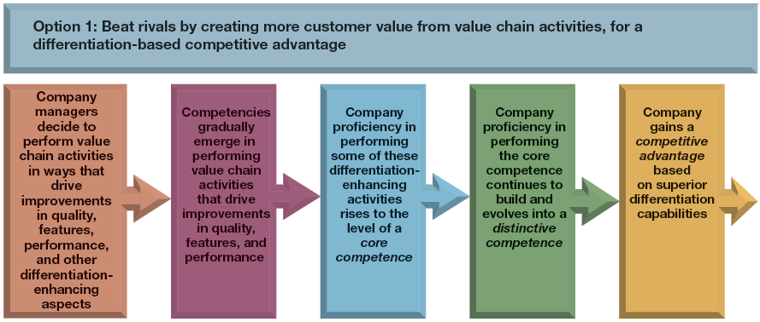
OPTION 1 FOR TRANSLATING PROFICIENT PERFORMANCE OF VALUE CHAIN ACTIVITIES INTO COMPETITIVE ADVANTAGE
Jump to Appendix 12 long image description

Slide 71
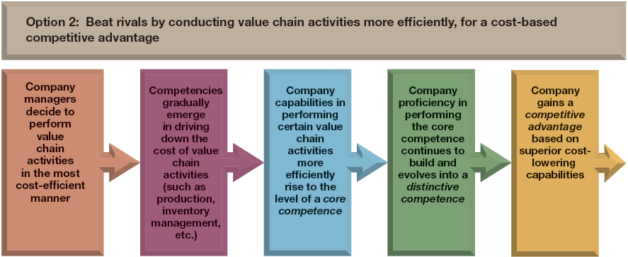
OPTION 2 FOR TRANSLATING PROFICIENT PERFORMANCE OF VALUE CHAIN ACTIVITIES INTO COMPETITIVE ADVANTAGE
Jump to Appendix 13 long image description

Slide 72
QUESTION 5: IS THE FIRM COMPETITIVELY STRONGER OR WEAKER THAN KEY RIVALS?
Assessing the firm’s overall competitive strength
How does the firm rank relative to competitors on each of the important factors that determine market success?
Does the firm have a net competitive advantage or disadvantage versus major competitors?

Slide 73
Strategic management principle (11 of 14)
High-weighted competitive strength ratings signal a strong competitive position and possession of competitive advantage; low ratings signal a weak position and competitive disadvantage.

Slide 74
STEPS IN THE COMPETITIVE STRENGTH ASSESSMENT PROCESS
Make a list of the industry’s key success factors and measures of competitive strength or weakness.
Assign weights to each competitive strength measure based on its perceived importance.
Score competitors on each competitive strength measure and multiply by each measure by its corresponding weight.
Sum the weighted strength ratings on each factor to get an overall measure of competitive strength for each company.
Use overall strength ratings to draw conclusions about the company’s net competitive advantage or disadvantage and to take specific note of areas of strength and weakness.

Slide 75
TABLE 4.4 A Representative Weighted Competitive Strength Assessment
Competitive Strength Assessment
(rating scale: 1 = very weak, 10 = very strong)
 |  | ABC Co. |  | Rival 1 |  | Rival 2
Key Success Factor/ Strength Measure | Importance Weight | Strength Rating | Weighted Score | Strength Rating | Weighted Score | Strength Rating | Weighted Score
Quality/product performance | 0.10 | 8 | 0.80 | 5 | 0.50 | 1 | 0.10
Reputation/image | 0.10 | 8 | 0.80 | 7 | 0.70 | 1 | 0.10
Manufacturing capability | 0.10 | 2 | 0.20 | 10 | 1.00 | 5 | 0.50
Technological skills | 0.05 | 10 | 0.50 | 1 | 0.05 | 3 | 0.15
Dealer network/distribution capability | 0.05 | 9 | 0.45 | 4 | 0.20 | 5 | 0.25
New product innovation capability | 0.05 | 9 | 0.45 | 4 | 0.20 | 5 | 0.25
Financial resources | 0.10 | 5 | 0.50 | 10 | 1.00 | 3 | 0.30
Relative cost position | 0.30 | 5 | 1.50 | 10 | 3.00 | 1 | 0.30
Customer service capabilities | 0.15 | 5 | 0.75 | 7 | 1.05 | 1 | 0.15
Sum of importance weights | 1.00
Overall weighted competitive strength rating |  |  | 5.95 |  | 7.70 |  | 2.10
Jump to Appendix 14 long image description

Slide 76
Strategic management principle (12 of 14)
A company’s competitive strength scores pinpoint its strengths and weaknesses against rivals and point directly to the kinds of offensive and defensive actions it can use to exploit its competitive strengths and reduce its competitive vulnerabilities.

Slide 77
STRATEGIC IMPLICATIONS OF COMPETITIVE STRENGTH ASSESSMENT
The higher a firm’s overall weighted strength rating, the stronger its overall competitiveness versus rivals.
The rating score indicates the total net competitive advantage for a firm relative to other firms.
Firms with high competitive strength scores are targets for benchmarking.
The ratings show how a firm compares against rivals, factor by factor (or capability by capability).
Strength scores can be useful in deciding what strategic moves to make.

Slide 78
QUESTION 6: WHAT STRATEGIC ISSUES AND PROBLEMS MERIT FRONT-BURNER MANAGERIAL ATTENTION?
Strategic priority “how to” issues
How to meet challenges of new foreign competitors
How to combat the price discounting of rivals
How to both reduce high costs and prepare for price reductions
How to sustain growth as buyer demand slows
How to adapt to the changing demographics of the firm’s customer base

Slide 79
Strategic management principle (13 of 14)
Compiling a list of problems and roadblocks creates a strategic agenda of problems that merit prompt managerial attention.

Slide 80
QUESTION 6: WHAT STRATEGIC ISSUES AND PROBLEMS MERIT FRONT-BURNER MANAGERIAL ATTENTION?
Strategic priority “should we” issues
Expand rapidly or cautiously into foreign markets?
Reposition the firm to move to a different strategic group?
Counter increasing buyer interest in substitute products?
Expand the firm’s product line?
Correct the firm’s competitive deficiencies by acquiring a rival firm with the missing strengths?

Slide 81
Strategic management principle (14 of 14)
A good strategy must contain ways to deal with all the strategic issues and obstacles that stand in the way of the company’s financial and competitive success in the years ahead.

Slide 82
Appendix 1 Figure 4.1 Identifying the Components of a Single-Business Company’s Strategy
Components include:
improved design, better features, higher quality, and lower prices to attract customers;
responding to changes in the macro-environment, industry, or competitive conditions;
competitive advantage based on lower costs, better products, superior service ability serving a market niche or specific group of buyers; varying geographic coverage;
partnering and building strategic alliances with other enterprises in the industry
Also listed are the key functional strategies of the business strategy (the action plan for managing a single business). They are: R&D, technology, product design strategy; supply chain management strategy; production strategy; sales, marketing, and distribution strategies; information technology strategy; human resources strategy; and finance strategy
Return to slide

Slide 83
Appendix 2 Table 4.1 Key Financial Ratios: How to Calculate Them and What They Mean
Gross profit margin. Sales revenues minus cost of goods sold divided by sales revenues. This shows the percentage of revenues available to cover operating expenses and yield a profit.
Operating profit margin (return on sales). Sales revenues minus operating expenses divided by sales revenues. Or operating income divided by sales revenues. This shows the profitability of current operations without regard to interest charges and income taxes. Earnings before interest and taxes is known as EBIT in financial and business accounting.
Net profit margin (net return on sales). Profits after taxes divided by sales revenues. This shows after-tax profits per dollar of sales.
Total return on assets. Profits after taxes plus interest divided by total assets. This shows a measure of the return on total investment in the enterprise. Interest is added to after-tax profits to form the numerator, since total assets are financed by creditors as well as by stockholders.
Net return on total assets (ROA). Profits after taxes divided by total assets. This shows a measure of the return earned by stockholders on the firm’s total assets.
Return on stockholders' equity (ROE). Profits after taxes divided by total stockholders' equity. This shows the return stockholders are earning on their capital investment in the enterprise. A return in the 12 percent to 15 percent range is average.
Return on invested capital (ROIC), sometimes known as return on capital employed (ROCE). Profits after taxes divided by the sum of long-term debt plus total stockholders' equity. This shows a measure of the return that shareholders are earning on the monetary capital invest in the enterprise. A higher return reflects greater bottom-line effectiveness in the use of long-term capital.
Return to slide

Slide 84
Appendix 3 Table 4.1 Key Financial Ratios: How to Calculate Them and What They Mean
Liquidity ratios:
Current ratio. Current assets divided by current liabilities. This shows a firm’s ability to pay current liabilities using assets that can be converted to cash in the near term. Ratio should be higher than 1.0.
Working capital. Current assets minus current liabilities. This shows the cash available for a firm’s day-to-day operations. Larger amounts mean the company has more internal funds to (1) pay its current liabilities on a timely basis and (2) finance inventory expansion, additional accounts receivable, and a larger base of operations without resorting to borrowing or raising more equity capital.
Leverage ratios:
Total debt-to-assets ratio. Total debt divided by total assets. This measures the extent to which borrowed funds (both short-term loans and long-term debt) have been used to finance the firm’s operations. A low ratio is better; a high fraction indicates overuse of debt and a greater risk of bankruptcy.
Long-term debt-to-capital ratio. Long-term debt divided by the sum of long-term debt plus total stockholder equity. This shows a measure of creditworthiness and balance sheet strength. It indicates the percentage of capital investment that has been financed by both long-term lenders and stockholders. A ratio below 0.25 is preferable since the lower the ratio, the greater the capacity to borrow additional funds. Debt-to-capital ratios above 0.50 indicate an excessive reliance on long-term borrowing, lower creditworthiness, and weak balance sheet strength.
Debt-to-equity ratio. Total debt divided by total stockholders' equity. This shows the balance between debt (funds borrowed both short term and long term) and the amount that stockholders have invested in the enterprise. The further the ratio is below 1.0, the greater the firm’s ability to borrow additional funds. Ratios above 1.0 put creditors at greater risk, signal weaker balance sheet strength, and often result in lower credit ratings.
Long-term debt-to-equity ratio. Long-term debt divided by total stockholders' equity. This shows the balance between long-term debt and stockholders’ equity in the firm’s long-term capital structure. Low ratios indicate a greater capacity to borrow additional funds if needed.
Times-interested-earned (or coverage) ratio. Operating income divided by interest expenses. This measures the ability to pay annual interest charges. Lenders usually insist on a minimum ratio of 2.0, but ratios above 3.0 signal progressively better creditworthiness.
Return to slide

Slide 85
Appendix 4 Table 4.1 Key Financial Ratios: How to Calculate Them and What They Mean
Days of inventory. Inventory divided by the quotient of cost of goods sold divided by 365. This measures inventory management efficiency. Fewer days of inventory are better.
Inventory turnover. Cost of goods sold divided by inventory. This measures the number of inventory turns per year. Higher is better.
Average collection period. Accounts receivable divided by the quotient of total sales divided by 365. Or accounts receivable divided by average daily sales. This indicates the average length of time the firm waits after making a sale to receive cash payment. A shorter collection time is better.
Return to slide

Slide 86
Appendix 5 Table 4.1 Key Financial Ratios: How to Calculate Them and What They Mean
Dividend yield on common stock. Annual dividends per share divided by current market price per share. This shows a measure of the return that shareholders receive in the form of dividends. A “typical” dividend yield is 2 percent to 3 percent. The dividend yield for fast-growth companies is often below 1 percent; the dividend yield for slow-growth companies can run 4 percent to 5 percent.
Price-to-earnings (P/E) ratio. Current market price per share divided by earnings per share. This shows that P/E ratios above 20 indicate strong investor confidence in a firm’s outlook and earnings growth; firms whose future earnings are at risk or likely to grow slowly typically have ratios below 12.
Dividend payout ratio. Annual dividends per share divided by earnings per share. This indicates the percentage of after-tax profits paid out as dividends.
Internal cash flow. After-tax profits plus depreciation. This shows a rough estimate of the cash a company’s business is generating after payment of operating expenses, interest, and taxes. Such amounts can be used for dividend payments or funding capital expenditures.
Free cash flow. After-tax profits plus depreciation minus capital expenditures minus dividends. This shows a rough estimate of the cash a company’s business is generating after payment of operating expenses, interest, taxes, dividends, and desirable reinvestments in the business. The larger a company’s free cash flow, the greater its ability to internally fund new strategic initiatives, repay debt, make new acquisitions, repurchase shares of stock, or increase dividend payments.
Return to slide

Slide 87
Appendix 6 Table 4.2 Types of Company Resources
Tangible resources:
Physical resources: land and real estate; manufacturing plants, equipment, or distribution facilities; the locations of stores, plants, or distribution centers, including the overall pattern of their physical locations; ownership of or access rights to natural resources (such as mineral deposits)
Financial resources: cash and cash equivalents; marketable securities; other financial assets such as a company’s credit rating and borrowing capacity
Technological assets: patents, copyrights, production technology, innovation technologies, technological processes
Organizational resources: IT and communication systems (satellites, servers, workstations, etc.); other planning, coordination, and control systems; the company’s organizational design and reporting structure.
Intangible resources:
Human assets and intellectual capital: the education, experience, knowledge, and talent of the workforce, cumulative learning, and tacit knowledge of employees; collective learning embedded in the organization, the intellectual capital, and know-how of specialized teams and work groups; the knowledge of key personnel concerning important business functions; managerial talent and leadership skill; the creativity and innovativeness of certain personnel
Brands, company image, and reputational assets: brand names, trademarks, product or company image, buyer loyalty and goodwill; company reputation for quality, service, and reliability; reputation with suppliers and partners for fair dealing
Relationships: alliances, joint ventures, or partnerships that provide access to technologies, specialized know-how, or geographic markets; networks of dealers or distributors; the trust established with various partners
Company culture and incentive system: the norms of behavior, business principles, and ingrained beliefs within the company; the attachment of personnel to the company’s ideals; the compensation system and the motivation level of company personnel
Return to slide

Slide 88
Appendix 7 VRIN: Four Tests of a Resource’s Competitive Power
A resource has support for a competitive advantage if it is valuable and rare.
A resource has support for sustained competitive advantage if it is inimitable and non-substitutable.
Return to slide

Slide 89
Appendix 8 Figure 4.2 The Steps Involved in SWOT Analysis: Identify the Four Components of SWOT, Draw Conclusions, Translate Implications into Strategic Actions
What can be gleaned from the SWOT listings?
The first two steps of SWOT analysis are:
Identify company strengths and competitive assets
Identify company weaknesses and competitive deficiencies
These two steps lead to conclusions concerning the company’s overall business situation. This includes determining where on the scale from “alarmingly weak” to “exceptionally strong” the attractiveness of the company’s situation ranks. It also includes what the attractive and unattractive aspects of the company’s situation are.
The last two steps of SWOT analysis are:
Identify the company's market opportunities
Identify external threats to the company's future well-being
These two steps reveal implications for improving company strategy. This includes using company strengths as the foundation for the company’s strategy; pursuing those market opportunities best suited to company strengths; correcting weaknesses and deficiencies that impair pursuit of important market opportunities or heighten vulnerability to external threats; and using company strengths to lessen the impact of important external threats.
Return to slide

Slide 90
Appendix 9 Figure 4.3 A Representative Company Value Chain
Primary activities and costs of a company's value chain are:
Supply chain management
Operations
Distribution
Sales and marketing service
Profit margin
These primary activities and costs are supported by the following
Product R&D
Technology
Systems development
Human resource management
General administration
Return to slide

Slide 91
Appendix 10 Figure 4.4 A Representative Value Chain System
A representative value chain system shows the following
Supplier-related value chains: activities, costs, and margins of suppliers
A company's own value chain: internally performed activities, costs, and margins
Forward-channel value chains: (1) activities, costs, and margins of forward-channel allies and strategic partners and (2) buyer or end-user value chains
Return to slide

Slide 92
Appendix 11 Illustration Capsule 4.1 The Value Chain for Boll & Branch
The cost of goods, including the raw cotton; the spinning, weaving, and dyeing; cutting, sewing, and finishing; the transportation of the material, and the factory fee is $68.46.
The inspection fees, ocean freight/insurance, import duties, warehouse/packing, packaging, customer shipping, and promotions/donations total $154.38.
Boll & Branch’s markup is about 60%.
Boll & Branch’s retail price is $250.00, resulting in a gross margin of $95.62.
Return to slide

Slide 93
Appendix 12 Option 1 for Translating Proficient Performance of Value Chain Activities into Competitive Advantage
The steps a company would take to beat rivals by creating more customer value from value chain activities, for a differentiation-based competitive advantage
Managers decide to perform value chain activities to drive improvements in quality, features, performance and other differentiation-enhancing aspects.
Competencies gradually emerge in performing activities that drive improvements in quality, features, and performance.
Company proficiency in performance some of the differentiation-enhancing activities rises to the level of a core competence.
Company proficiency in the core competence continues to build and evolves into a distinctive competence.
Company gains a competitive advantaged based on superior differentiation capabilities.
Return to slide

Slide 94
Appendix 13 Option 2 for Translating Proficient Performance of Value Chain Activities into Competitive Advantage
The steps a company would take to beat rivals by conducting value chain activities more efficiently, for a cost-based competitive advantage
Managers decide to perform value chain activities in the most cost-efficient manner.
Competencies gradually emerge in driving down the cost of value chain activities (such as production, inventory, management, etc.).
Company capabilities in performing certain value chain activities more efficiently rises to the level of a core competence.
Company proficiency in the core competence continues to build and evolves into a distinctive competence.
Company gains a competitive advantaged based on superior cost-lowering capabilities.
Return to slide

Slide 95
Appendix 14 Table 4.4 A Representative Weighted Competitive Strength Assessment
Rating scale: 1 equals very weak, 10 equals very strong
Key success factor/strength measure | Importance weight | ABC Co. Strength Rating |  | ABC Co. Weighted Score |  | Rival 1 Strength Rating | Rival 1 Weighted score | Rival 2 Strength Rating | Rival 2 Weighted Score
Quality/product performance | 0.10 | 8 |  | 0.80 |  | 5 | 0.50 | 1 | 0.10
Reputation/image | 0.10 | 8 |  | 0.80 |  | 7 | 0.70 | 1 | 0.10
Manufacturing capability | 0.10 | 2 |  | 0.20 |  | 10 | 1.00 | 5 | 0.50
Technological skills | 0.05 | 10 |  | 0.50 |  | 1 | 0.05 | 3 | 0.15
Dealer network/ distribution capability | 0.05 | 9 |  | 0.45 |  | 4 | 0.20 | 5 | 0.25
New product innovation capability | 0.05 | 9 |  | 0.45 |  | 4 | 0.20 | 5 | 0.25
Financial resources | 0.10 | 5 |  | 0.50 |  | 10 | 1.00 | 3 | 0.30
Relative cost position | 0.30 | 5 |  | 1.50 |  | 10 | 3.00 | 1 | 0.30
Customer servicer capabilities | 0.15 | 5 |  | 0.75 |  | 7 | 1.05 | 1 | 0.15
Sum of importance weights | 1.00
Overall weighted |  |  | ABC Co.=5.95 |  |  |  | Rival 1 = 7.70 |  | Rival 2 = 2.10
Return to slide

